Slide 1
CST 205 OOP MODULE 4 EVENT HANDLING-PART 1

Slide 2
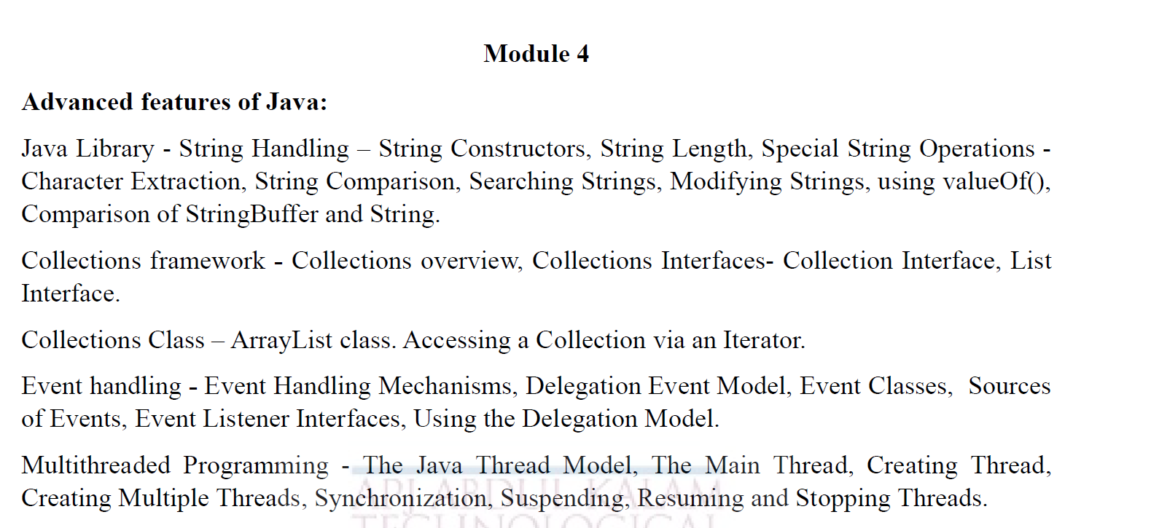

Slide 3


Slide 4
OBJECTIVES
To introduce concept of event handling mechanisms in Java.
To illustrate Delegation event model.
To give an overview of Event classes and action listeners.

Slide 5
INTRODUCTION
Event handling is fundamental to Java programming because it is integral to the creation of applets and other types of GUI-based programs.
Thus event handling is at the core of successful applet programming.
The most commonly handled events are those
Generated by mouse
Keyboard
Various controls like buttons,dropdown,radiobutons,checkboxes etc
Events are supported by a number of packages,
including java.util, java.awt, and java.awt.event

Slide 6
EVENT MODEL
Based on delegation event model
Defines standard and consistent mechanisms to generate and process events.
A source generates an event and sends it to one or more listeners.
Here the listener simply waits until it receives an event.
Once received, the listener processes the event and then returns.
Adv:- the application logic that processes events is cleanly separated from the user interface logic that generate those events.
A user interface element is able to “delegate” the processing of an event to a separate piece of code.

Slide 7
The Delegation Event Model
The Delegation Event Model has the following key participants namely:
Source -
The source is an object on which event occurs.
Source is responsible for providing information of the occurred event to it's handler.
Java provide as with classes for source object.
Listener -
It is also known as event handler.
Listener is responsible for generating response to an event.
The listener is also an object and it waits until it receives an event.
Once the event is received , the listener process the event and then returns.

Slide 8
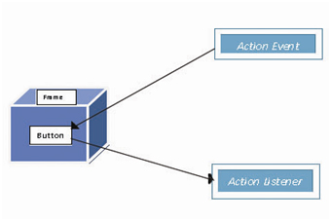
EVENT MODEL
The listeners must register with a source inorder to receive an event notification
Benefit :- Notifications are sent only to listeners that want to receive them

Slide 9
EVENT MODEL
In the delegation event model, listeners must register with a source in order to receive an event notification. This provides an important benefit: notifications are sent only to listeners that want to receive them.
This is a more efficient way to handle events than the design used by the old Java 1.0 approach.
Previously, an event was propagated up the containment hierarchy until it was handled by a component.
This required components to receive events that they did not process, and it wasted valuable time.
The delegation event model eliminates this overhead.

Slide 10
EVENTS
An event describes the change in state of source.
Events are generated as result of user interaction with the graphical user interface components.
Eg :- activities that cause events :-
pressing a button
entering a character via the keyboard
selecting an item in a list
clicking the mouse

Slide 11
EVENTS
Events may also occur that are not directly caused by the interactions with a user interface
Eg :- when a timer expires
a counter exceeds a value
a software or hardware failure occurs
EVENT SOURCES
A source is an object that generates an event.
This occurs when the internal state of that object changes in some way.
A source must register listeners in order for the listeners to receive notifications about a specific type of event.

Slide 12
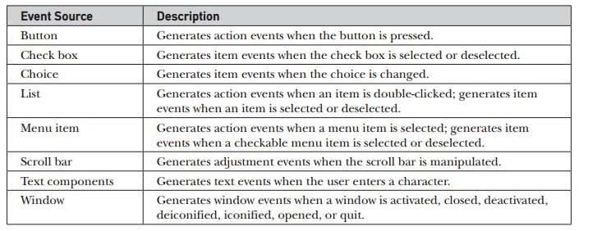
Event Source Examples

Slide 13
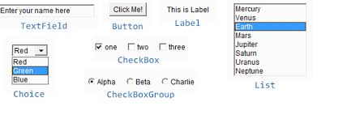
Event Source Examples

Slide 14
EVENT LISTENERS
Each type of event has its own registration method.
General form :
public void addTypeListener(TypeListener el)
Here Type is the name of the event and el is a reference to the event listener
Eg:-
A method that registers a keyboard event listener is called addKeyListener()
A method that registers a mouse motion listener is called addMouseMotionListener()
When an event occurs , all registered listeners are notified and receive a copy of the event object.
This is multicasting the event

Slide 15
EVENT LISTENERS
Some sources may allow only one listener to register.
General form :
public void addTypeListener(TypeListener el)
throws java.util.TooManyListenersException
Here Type is the name of the event and el is a reference to the event listener.
When such an event occurs, the registered listener is notified.
This is known as unicasting the event

Slide 16
EVENT LISTENERS
A source must also provide a method that allows a listener to unregister a specific event
General form :
public void removeTypeListener(TypeListener el)
Here Type is the name of the event and el is a reference to the event listener.
Eg:- to remove a keyboard listener, call removeKeyListener()

Slide 17
EVENT LISTENERS
A listener is an object that is notified when an event occurs.
It has two major requirements:
It must have been registered with one or more sources to receive notifications about specific events.
It must implement methods to receive and process these notifications.
The method that receive and process events are defined in a set of interfaces found in java.awt.event.
Eg:- the MouseMotionListener interface defines two methods to receive notifications when the mouse is dragged or moved.

Slide 18
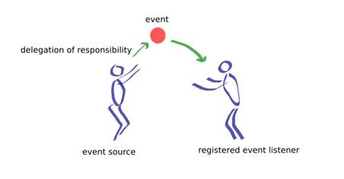
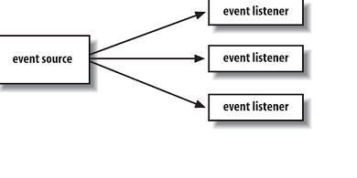
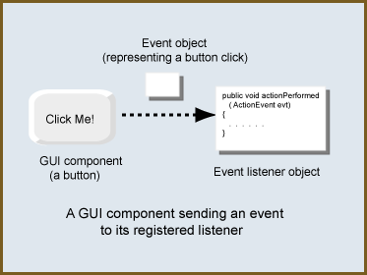

Slide 19
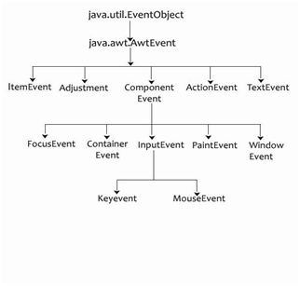
EVENT CLASSE HIERARCHY

Slide 20
1)EventObject
Root of event class hierarchy is EventObject which is in java.util
It is the superclass for all events.
Constructor is :
EventObject(Object src)
Here src is the object that generates this event
Two methods :
getSource()
toString()

Slide 21
1)EventObject
Object getSource() :- returns the source of the event.
String toString() :- returns the string equivalent of the event.
2)AWTEvent
Defined in java.awt package
Subclass of EventObject
It is the superclass of all AWT events that are handled by the delegation event model
Constructor :
public AWTEvent(Object src, int id)
Here source-> where event is generated
id -> type of event
Method :-
int getID()

Slide 22
3) ActionEvent
It is generated
when a button is pressed
A list item is double clicked
Or a menu item is selected
If a class performs some actions like this, it implement ActionListener interface
Constructor :
public ActionEvent(Object src, int type, String cmd)
Here src-> reference to the object that generated this event
type->type of the event
cmd-command string associated with the event

Slide 23
3) ActionEvent
2) public ActionEvent(Object src, int type, String cmd, int modifiers)
modifiers-indicates which modifier keys (ALT,CTRL OR SHIFT) were pressed when the event was generated
Methods :-
1)String getActionCommand()
Can obtain the command name
Eg:- When a button is pressed, an actionevent is generated that has a command name equal to the label on that button.
2)int getModifiers()
Returns a value that indicates which modifier keys were pressed.

Slide 24
4.InputEvent:
The InputEvent class extends from the ComponentEvent class.
This event class handles all the component-level input events.
This class acts as a root class for all component-level input events.
Direct Known Subclasses: KeyEvent, MouseEvent

Slide 25
5)MouseEvent
8 types of mouse events:
It is defined by the following integer constants :
MOUSE_CLICKED | the user clicked the mouse
MOUSE_DRAGGED | the user dragged the mouse
MOUSE_ENTERED | the mouse entered a component
MOUSE_EXITED | the mouse exited from a component
MOUSE_MOVED | the mouse moved
MOUSE_PRESSED | the mouse was pressed
MOUSE_RELEASED | the mouse was released
MOUSE_WHEEL | the mouse wheel was moved

Slide 26
5)MouseEvent
MouseEvent is a subclass of InputEvent
Constructor:
MouseEvent(Component src, int type, long when, int modifiers, int x, int y, int clicks,Boolean triggersPopup)
Src-> is a reference to the component that generated the event
Type-> the type of the event
When-> the system time at which the mouse event occurred
Modifiers-> which modifiers were pressed when a mouse event occurred
x,y-> the co-ordinates of the mouse
Clicks-> no of mouse clicks
triggersPopup-> indicates if this event causes a pop-up menu to appear on this platform

Slide 27
MouseEvent Methods:
1)public int getX()
Returns the x position of the event relative to the source component.
2) public int getY()
Returns the y position of the event relative to the source component.
3) public Point getPoint()
Returns the x,y position of the event relative to the source component.
4) public int getClickCount()
Return the number of mouse clicks associated with this event.
5) public boolean isPopupTrigger()
Returns whether or not this mouse event is the popup-menu trigger event for the platform.

Slide 28
6.The KeyEvent Class
A KeyEvent is generated when keyboard input occurs.
There are three types of key events,which are identified by these integer constants: KEY_PRESSED, KEY_RELEASED, and KEY_TYPED.
The first two events are generated when any key is pressed or released.
The last event occurs only when a character is generated.
Remember, not all keypresses result in characters. For example, pressing SHIFT does not generate a character

Slide 29
The KeyEvent Class
CONSTRUCTOR
KeyEvent(Component src, int type, long when, int modifiers, int code, char ch)
src is a reference to the component that generated the event.
The type of the event is specified by type.
The system time at which the key was pressed is passed in when.
The modifiers argument indicates which modifiers were pressed when this key event occurred.
The virtual key code, such as VK_UP, VK_A, and so forth, is passed in code.
The character equivalent (if one exists) is passed in ch

Slide 30
The KeyEvent Class
The KeyEvent class defines several methods, but the most commonly used ones are
getKeyChar( ), which returns the character that was entered
getKeyCode( ), which returns the key code.
Their general forms are shown here:
char getKeyChar( )
int getKeyCode( )
If no valid character is available, then getKeyChar( ) returns CHAR_UNDEFINED

Slide 31
6)Adjustment Event
It is generated by a scroll bar
5 types:
TYPE | MEANING
BLOCK_DECREMENT | The user clicked inside the scroll bar to decrease its value
BLOCK_INCREMENT | The user clicked inside the scroll bar to increase its value
TRACK | The slider was dragged
UNIT_DECREMENT | The button at the end of the scroll bar was clicked to decrease its value[the bottom arrow of a vertical scroll bar]
UNIT_INCREMENT | The button at the end of the scroll bar was clicked to increase its value

Slide 32
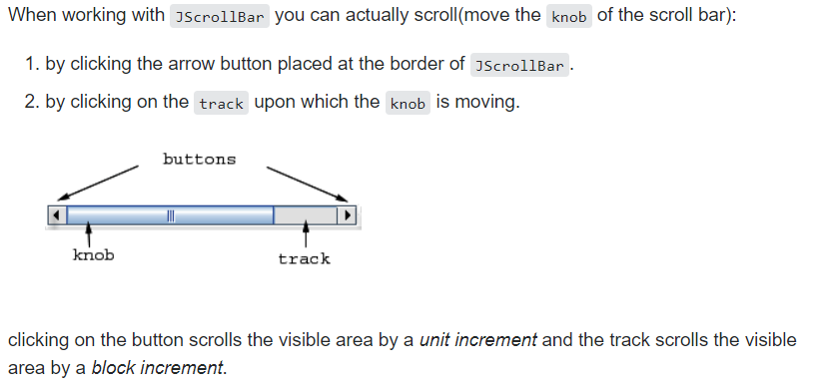
6)Adjustment Event

Slide 33
6)Adjustment Event
Constructor :-
AdjustmentEvent(Adjustable src, int id, int type, int data)
Here src-> reference to the object that generated this event
id->ADJUSTMENT_VALUE_CHANGED
type-> type of the event
data->associated data
Methods :-
1) Adjustable getAdjustable()
returns the object that generated the event
2) int getAdjustmentType()
returns the type of the adjustment event. It returns one of the constants defined by AdjustmentEvent class

Slide 34
7)ComponentEvent Class
A ComponentEvent is generated when the size, position or visibility of a component is changed.
4 types:
TYPE | MEANING
COMPONENT_HIDDEN | The component was hidden
COMPONENT_MOVED | The component was moved
COMPONENT_RESIZED | The component was resized
COMPONENT_SHOWN | The component became visible

Slide 35
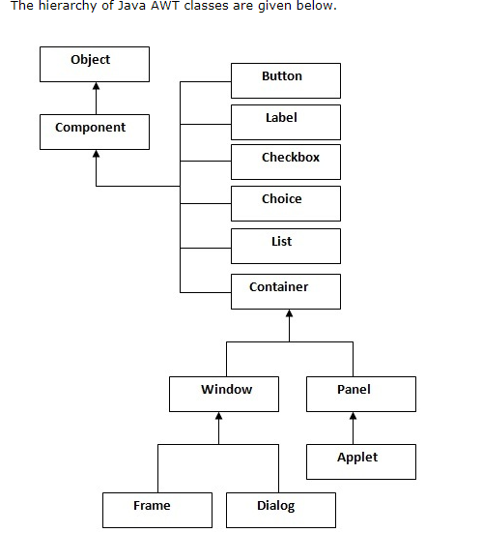

Slide 36


Slide 37
ComponentEvent Class
Constructor:
ComponentEvent(Component src, int type)
‘src’ is the reference to the object that generated this event. Type of event is specified by ‘type’.
Methods :-
1) Component getComponent()-returns the component that generated an event.

Slide 38
8)Focus Event
Event is generated when a component gains or losses input focus.
2 types of events:
FOCUS_LOST and FOCUS_GAINED
Constructors: FocusEvent(Component src, int type) FocusEvent(Component src,int type,boolean temporaryFlag) FocusEvent(Component src, int type, boolean temporaryFlag, Component other)

Slide 39
8)Focus Event
Here src’ is the reference to the component that generated this event. ‘type’ is the type of event.
‘temporaryFlag’ is set to true if the FocusEvent is temporary otherwise it is set to false.
‘other’ which is involved in focus change, called the opposite component is passed in other. Methods: 1) Component getOppositeComponent()-The opposite component is returned. 2)boolean isTemporary()-returns true if the change is temporary, otherwise it returns false.

Slide 40
9.The TextEvent Class
Instances of this class describe text events. These are generated by text fields and text areas when characters are entered by a user or program.
The one constructor for this class is shown here:
TextEvent(Object src, int type)
Here, src is a reference to the object that generated this event.
The type of the event is specified by type.

Slide 41
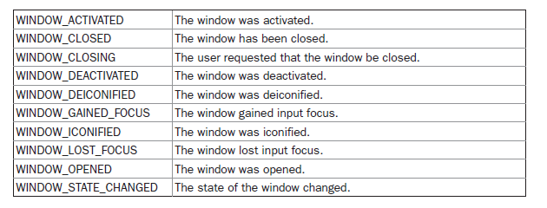
10 WindowEvent
TheWindowEvent class defines integer constants that can be used to identify them.
The constants and their meanings are shown here:

Slide 42
11.The ItemEvent Class
An ItemEvent is generated when a check box or a list item is clicked or when a checkable menu item is selected or deselected.
ItemEvent defines one integer constant, ITEM_STATE_CHANGED, that signifies a change of state.
There are two types of item events, which are identified by the following integer constants:

Slide 43
11.The ItemEvent Class
ItemEvent has this constructor:
ItemEvent(ItemSelectable src, int type, Object entry, int state)
src is a reference to the component that generated this event. For example, this might be a list or choice element.
The type of the event is specified by type.
The specific item that generated the item event is passed in entry. The current state of that item is in state.
The getItem( ) method can be used to obtain a reference to the item that generated an event.
Object getItem( )

Slide 44
11.The ItemEvent Class
The getItemSelectable( ) method can be used to obtain a reference to the ItemSelectable object that generated an event.
Its general form is shown here:
ItemSelectable getItemSelectable( )
Lists and choices are examples of user interface elements that implement the ItemSelectable interface.
The getStateChange( ) method returns the state change (that is, SELECTED or DESELECTED) for the event.
It is shown here:
int getStateChange( )

Slide 45
12.The ContainerEvent Class
A ContainerEvent is generated when a component is added to or removed from a container.
There are two types of container events.
The ContainerEvent class defines int constants that can be used to identify them: COMPONENT_ADDED and COMPONENT_REMOVED.
ContainerEvent is a subclass of ComponentEvent and has this constructor:
ContainerEvent(Component src, int type, Component comp)
Here, src is a reference to the container that generated this event. The type of the event is specified by type, and the component that has been added to or removed from the container is comp.

Slide 46
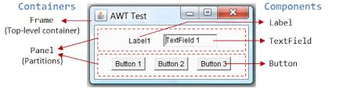
CONTAINERS AND COMPONENTS

Slide 47
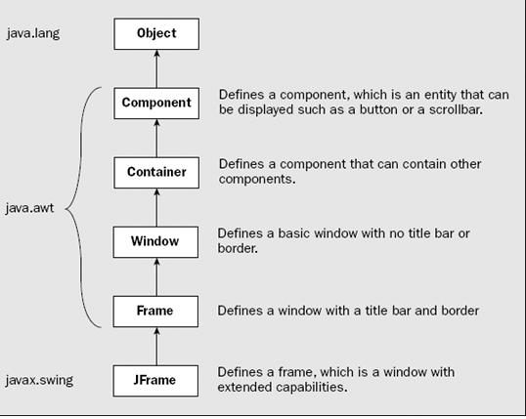
CONTAINERS AND COMPONENTS

Slide 48
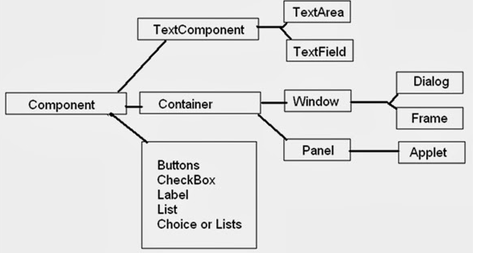
CONTAINERS AND COMPONENTS

Slide 49
12.The ContainerEvent Class
You can obtain a reference to the container that generated this event by using the getContainer( ) method , shown here:
Container getContainer( )
The getChild( ) method returns a reference to the component that was added to or removed from the container. Its general form is shown here:
Component getChild( )

Slide 50
Steps involved in event handling
The User clicks the button and the event is generated.
Now the object of concerned event class is created automatically and information about the source and the event get populated with in same object.
Event object is forwarded to the method of registered listener class.
The method is now get executed and returns.

Slide 51
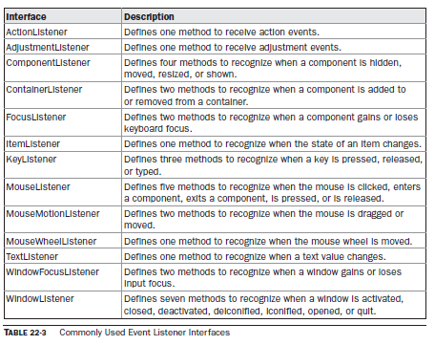
Event Listener Interfaces(java.awt.event)

Slide 52
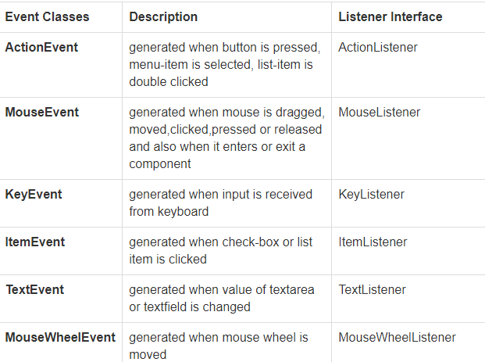
Important Event Classes and Interface

Slide 53
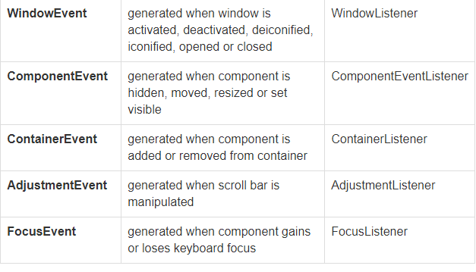
Important Event Classes and Interface

Slide 54
CONCLUSION
Event handling is fundamental to Java programming because it is integral to the creation of applets and
other types of GUI-based programs.
The Delegation Event Model has the following key participants namely:
Source -
The source is an object on which event occurs.
Listener -
It is also known as event handler.
Listener is responsible for generating response to an event.

